Slide 1


Content Popularity Analysis for Social Buzz:
Insights into Top Categories

Slide 2


Today's agenda
> Project recap
> Problem
> The Analytics team
> Process
> Insights
> Summary

Slide 3

As a fast-growing technology unicorn, Social Buzz demands quick adaptation to its global scale. The following tasks will be the focus of Accenture's three-month proof-of-concept:
Audit of Big Data practices at Social Buzz
Recommendations for launching a successful IPOs
Identifying Social Buzz's five most popular content categories
Project Recap

Slide 4

Problem
Over 10000 posts per day
36500000 pieces of content per year!
How do we capitalize on it when there is so much?
Analysis to find Social Buzz’s top 5 most popular categories of content

Slide 5
Andrew Fleming
Chief Technical Architect
The Analytics team
Marcus Rompton
Senior Principle
Abinanda Manoj
Data Analyst

Slide 6
Process
1
Understanding Data
2
Data Cleaning
3
Data Transformation
4
Analysis
5
Result Interpretation

Slide 7

Insights
JANUARY
HIGHEST NUMBER OF POSTS
1897
‘ANIMAL’ POST REACTIONS
16
DISTINCT CATEGORIES

Slide 8
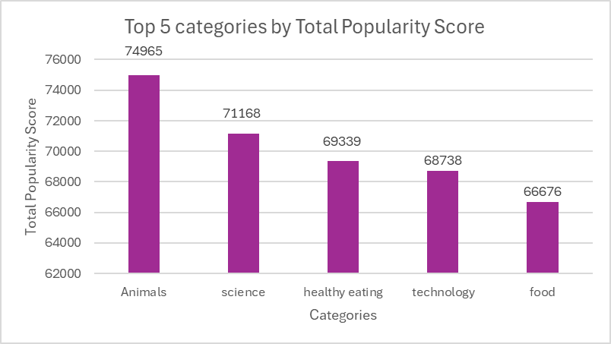

Slide 9
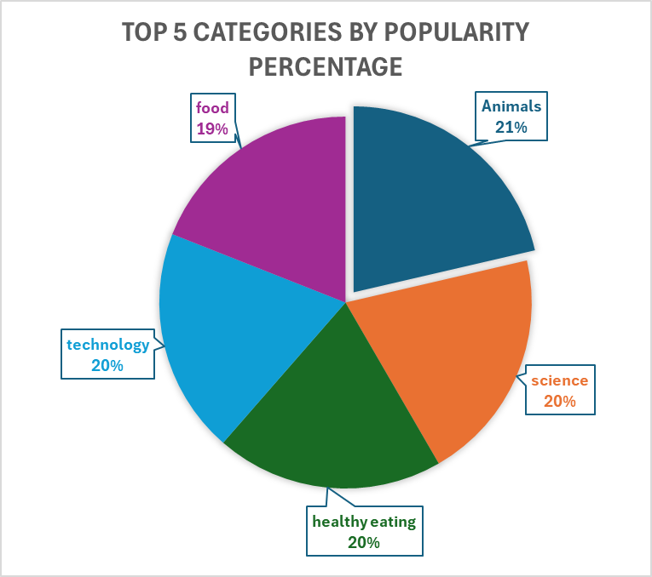

Slide 10

ANALYSIS:
Animals are the most popular category for posts, followed by science, technology, and healthy eating.
This trend suggests that people are particularly drawn to content related to both everyday, relatable topics and advancements in knowledge and lifestyle.
INSIGHTS:
Since animal content is the most popular category among users, this insight offers valuable direction for the company's engagement strategy. Partnering with pet shelters, animal welfare organizations, or even pet product brands could help create meaningful campaigns that resonate with the audience. These partnerships could involve promoting adoptable animals, hosting virtual pet events, or creating interactive, user-driven content, like sharing pet photos or stories. Such initiatives not only boost user engagement but also build a community around shared interests, potentially increasing brand loyalty and expanding reach within this enthusiastic audience segment.
NEXT STEPS:
To help you maximize these insights and drive impactful results, let’s work together on implementing these strategies. We’re excited to support you in reaching this goal!
Summary

Slide 11
Thank you!
ANY QUESTIONS?

